Slide 1
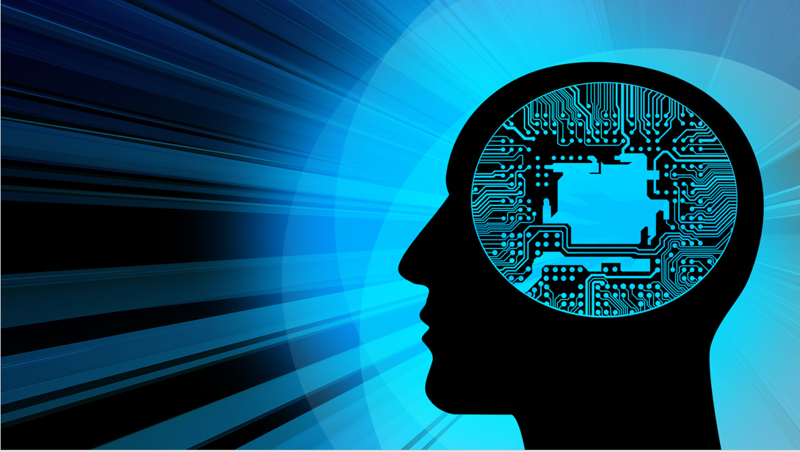

Introduction to Artificial Intelligence
Book: Artificial Intelligence, A Modern Approach (Russell & Norvig)
Ybralem B.

Slide 2

Chapter One
Introduction to Artificial Intelligence

Slide 3
Chapter objectives:
  Objectives/Goals of AI
  What is AI?
  Approaches to AI – making computer:
    Think like a human (Thinking humanly)
    Act like a human (Acting humanly)
    Think rationally (Thinking rationally)
    Act rationally (Acting rationally)
  The Foundations of AI
  Bits of History and the State of the Art

Slide 4
What is Artificial Intelligence?
AI is composed of two words Artificial and Intelligence.
  Artificial defines "man-made," and
  Intelligence defines "thinking power", or “the ability to learn and solve problems”
  Hence, Artificial Intelligence means "a man-made thinking power."
So, we can define Artificial Intelligence (AI) as creating of intelligent machines which can behave like a human, think like humans, and able to make decisions.

Slide 5
…cont’d
Artificial intelligence (AI) is a wide-ranging branch of computer science concerned with building smart machines capable of performing tasks that typically require human intelligence.
Examples of these tasks are:-
  Speech recognition, language translation
  Performing surgical operation
  Driving a car in traffic (self-driving cars)
  Playing chess
  Virtual assistants (e.g., Siri, Alexa)
  Recommendation systems (e.g., Netflix, Amazon) and
  Proving a mathematical theorem

Slide 6
What is Artificial Intelligence?
Understand intelligent entities
  Learn more about ourselves/animals, so researchers can draw inspiration for developing AI systems.
Build intelligent entities
  Create things that exhibit ‘intelligence’
  The focus is on constructing things that can learn, reason, adapt, and solve problems autonomously.
Study constructed intelligent entities
  These constructed entities are interesting and useful in their own right! so
  After building AI systems, researchers and engineers study them to understand how these constructed systems behave in different environments, how they learn, and how they solve problems.
  This study not only enhances AI development but also provides insights into the nature of intelligence itself.

Slide 7
Approaches to AI – making computer
Views of AI fall into four categories:
Systems that think like humans (cognitive science) | Systems that think rationally (logic/laws of thought)
Systems that act like humans (c.f. Turing test) | Systems that act rationally (agents)
THOUGHT
BEHAVIOUR
HUMAN
RATIONAL
Notes:
Think/act like humans/animals - Better understanding of human/animal intelligence. Emulate and model human/animal behaviour.
Think/act rationally - Develop inspired techniques which lead to smarter programs and machines. Optimise performance.
Systems that think like humans
“ … machine with minds, in the full and literal sense” (Haugeland 1985)
“… human thinking, activities such as decision-making, problem solving, learning …” (Bellman 1978)
Systems that act like humans
“… creating machines that perform functions that require intelligence when performed by people” (Kurzweil, 1990)
“… make computers do things at which, at the moment, people are better.” (Rich and Knight, 1991)
Systems that think rationally
“The study of mental faculties through the use of computational models” (Charniak et al. 1985)
“The study of the computations that make it possible to perceive, reason, and act.” (Winston, 1992)
Systems that act rationally
“… the study of the design of intelligent agents.” (Poole et al., 1998)
“… is concerned with intelligent behavior in artefacts.” (Nilsson, 1998)

Slide 8
Thinking Humanly (cognitive science) | Thinking Rationally (logic/laws of thought)
“The exciting new effort to make computers think ... machines with minds, in the full and literal sense.” (Haugeland, 1985) “[The automation of] activities that we associate with human thinking, activities such as decision-making, problem solving, learning ...” (Bellman, 1978) | “The study of mental faculties through the use of computational models.” (Charniak and McDermott, 1985) “The study of the computations that make it possible to perceive, reason, and act.” (Winston, 1992)
Acting Humanly (Turing test) | Acting Rationally (agents)
“The art of creating machines that perform functions that require intelligence when performed by people.” (Kurzweil, 1990) “The study of how to make computers do things at which, at the moment, people are better.” (Rich and Knight, 1991) | “Computational Intelligence is the study of the design of intelligent agents.” (Poole et al., 1998) “AI . . . is concerned with intelligent behavior in artifacts.” (Nilsson, 1998)
Notes:
Think/act like humans/animals - Better understanding of human/animal intelligence. Emulate and model human/animal behaviour.
Think/act rationally - Develop inspired techniques which lead to smarter programs and machines. Optimise performance.
Systems that think like humans
“ … machine with minds, in the full and literal sense” (Haugeland 1985)
“… human thinking, activities such as decision-making, problem solving, learning …” (Bellman 1978)
Systems that act like humans
“… creating machines that perform functions that require intelligence when performed by people” (Kurzweil, 1990)
“… make computers do things at which, at the moment, people are better.” (Rich and Knight, 1991)
Systems that think rationally
“The study of mental faculties through the use of computational models” (Charniak et al. 1985)
“The study of the computations that make it possible to perceive, reason, and act.” (Winston, 1992)
Systems that act rationally
“… the study of the design of intelligent agents.” (Poole et al., 1998)
“… is concerned with intelligent behavior in artefacts.” (Nilsson, 1998)

Slide 9
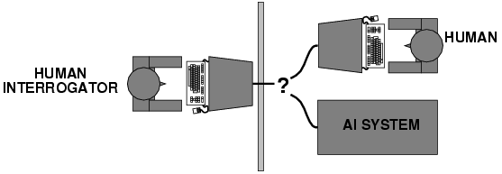
Acting humanly: Turing Test
Turing (1950) published "Computing machinery and intelligence":
"Can machines think?" → "Can machines behave intelligently?"
He proposed Operational test for intelligent behavior named the Imitation Game
Approaches of Turing Tests:-
  Interrogator asks the questions of both computer & human via teletype, and receive answers from each of them.
  All three entities sit in an isolated location.
  Computer passes the Turing test if the interrogator cannot distinguish computer responses from human responses.

Slide 10
… cont’d
Cont.…
To pass classical Turing Test computer needs to have the following capabilities
  Natural language processing: to enable it to communicate successfully in English;
  Knowledge representation: to store what it knows or hears;
  Automated reasoning: to use the stored information to answer questions and to draw new conclusions
  Machine learning: to adapt to new circumstances and to detect and extrapolate patterns.
  To pass Total Turing Test : where the interrogator can also test perceptual abilities (via video signal) as well as the opportunity for the interrogator to pass physical objects “through the hatch.” To pass the total Turing Test, the computer will need:-
  Computer vision :to perceive objects, and
  Robotics: to manipulate objects and move about.

Slide 11
Thinking humanly: cognitive modeling
When we say a given program thinks like a human, we must have some way of determining “how humans think?”. We need to get inside the actual workings of human minds.
There are three ways to do this:
  through introspection: trying to catch our own thoughts as they go by
  through psychological experiments: observing a person in action and
  through brain image: observing brain in action using technologies like fMRI (Functional Magnetic Resonance Imaging) to observe brain activity while a person is thinking or performing tasks. ()
This is the focus of Cognitive Science: brings together computer models from AI and experimental techniques from psychology to try to construct precise and testable theories of the workings of the human mind.

Slide 12
Thinking rationally: "laws of thought"
A system is rational if it thinks/does the right thing through correct reasoning and always reaches the right conclusions based on logical rules.
Aristotle:
  provided the correct arguments/ thought structures that always gave correct conclusions given correct premises.
    Example: Aristotle is a man; all men are mortal; therefore Aristotle is mortal
    This is an example of deductive reasoning, where the conclusion logically follows from the premises.
  These Laws of thought governed the operation of the mind and initiated the field of Logic.
  Rational thinking means following the rules of logic to ensure that conclusions drawn from premises are always valid and correct.
  A system is considered rational if it consistently applies these rules in its reasoning and decision-making processes.

Slide 13
…cont’d
Problems:
  It is not easy to take informal knowledge and state it in the formal terms required by logical notation (when knowledge is <100% certain).
  There is a big difference between solving a problem in principle and solving it in practice.
  Not all intelligent behavior is controlled by logic.
  What is the purpose of thinking? What thoughts should I have?

Slide 14
Acting rationally: rational agent
Rational behavior: doing the right thing so as to achieve one’s goal, given one’s beliefs/ according to the information that is available.
AI is the study and construction of rational agents (an agent that perceives and acts)
Rational action requires the ability to represent knowledge and reason with it so as to reach good decision.
  Learning for better understanding of how the world works
limitation: computational limitations make perfect rationality unachievable
    Design best program for given machine resources
Doesn't necessarily involve thinking
e.g. blinking reflex – but thinking should be in the service of rational action

Slide 15
Suggested major components of AI
Natural Language processing
  (enable computers to communicate in human language, English, Amharic, ..)
Knowledge representation
  (schemes to store information, both facts and inferences, before and during interrogation)
Automated reasoning
  (use stored information to answer questions and to draw new conclusions)
Machine learning
  (To adapt to new circumstances and to detect ,extrapolate patterns and accumulate knowledge)
Computer vision
  (recognize objects based on patterns in the same way as the human visual system does)
Robotics
  (produce mechanical device capable of controlled motion; which enable computers to see, hear & take actions)

Slide 16
Advantages of Artificial Intelligence
High Accuracy with less errors: AI machines or systems are prone to less errors and high accuracy as it takes decisions as per pre-experience or information.
High-Speed: AI systems can be of very high-speed and fast-decision making, because of that AI systems can beat a chess champion in the Chess game.
High reliability: AI machines are highly reliable and can perform the same action multiple times with high accuracy.
Useful for risky areas: AI machines can be helpful in situations such as defusing a bomb, exploring the ocean floor, where to employ a human can be risky.
Digital Assistant: users such as AI technology is currently used by various E-commerce websites to show the products as per customer requirement.
Useful as a public utility: such as a self-driving car which can make our journey safer and hassle-free, facial recognition for security purpose, Natural language processing to communicate with the human in human-language, etc.

Slide 17
Disadvantages of Artificial Intelligence
High Cost: the hardware and software requirement of AI is very costly as it requires lots of maintenance to meet current world requirements.
Can't think out of the box: Even we are making smarter machines with Ai, but still they can't work out of the box, as the robot will only do that work for which thy are trained, or programmed.
Increase dependence on the machines: with the increment of technology, people are getting more dependent.
No original creativity: as humans are so creative and can imagine some ideas but still AI machines can't beat this power of human intelligence and can’t be creative and imaginative.
No feeling and Emotion: AI systems doesn’t have feeling so it can’t make any type of emotional attachment with humans.

Slide 18
Goals of AI
To build a machine which can perform a task that require human intelligence ex., playing chess games, Driving a car in traffic, proving a theorem, surgical operation
To Create Expert Systems − The systems which exhibit intelligent behaviour, learn, demonstrate, explain, and advice its users.

Slide 19
The Foundations of AI
Philosophy
  Logic, methods of reasoning, mind as physical system foundations of learning, language, rationality
Mathematics
  Formal representation and proof algorithms, computation, (un)decidability, (in)tractability, probability
Economics
  studying how people make choices that lead to preferred outcomes., decision theory
Neuroscience
  physical substrate for mental activity
Psychology
  phenomena of perception and motor control, experimental techniques
Computer engineering
  building fast computers
Control theory
  maximize an objective function over time/ using feedback to influence the behavior of a system in order to achieve the goal.
Linguistics
  knowledge representation, grammar

Slide 20
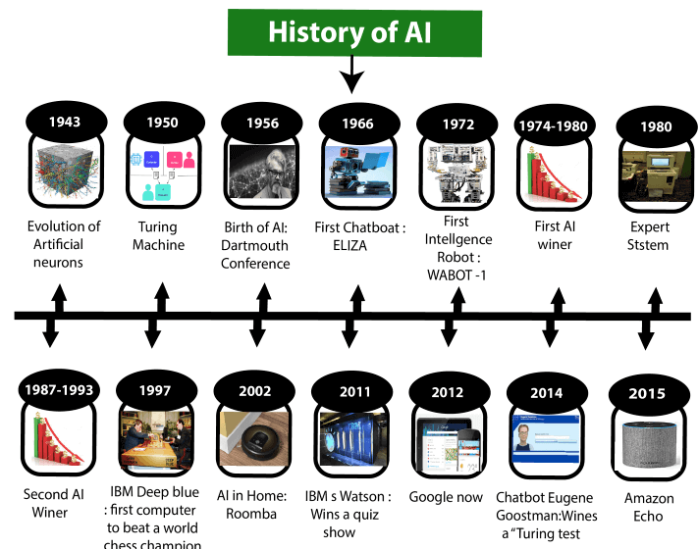
History of AI
Notes:
Maturation of Artificial Intelligence (1943-1952)
Year 1943: The first work which is now recognized as AI was done by Warren McCulloch and Walter pits in 1943. They proposed a model of artificial neurons.
Year 1949: Donald Hebb demonstrated an updating rule for modifying the connection strength between neurons. His rule is now called Hebbian learning.
Year 1950: The Alan Turing who was an English mathematician and pioneered Machine learning in 1950. Alan Turing publishes "Computing Machinery and Intelligence" in which he proposed a test. The test can check the machine's ability to exhibit intelligent behavior equivalent to human intelligence, called a Turing test.
The birth of Artificial Intelligence (1952-1956)
Year 1955: An Allen Newell and Herbert A. Simon created the "first artificial intelligence program"Which was named as "Logic Theorist". This program had proved 38 of 52 Mathematics theorems, and find new and more elegant proofs for some theorems.
Year 1956: The word "Artificial Intelligence" first adopted by American Computer scientist John McCarthy at the Dartmouth Conference. For the first time, AI coined as an academic field.
At that time high-level computer languages such as FORTRAN, LISP, or COBOL were invented. And the enthusiasm for AI was very high at that time.
The golden years-Early enthusiasm (1956-1974)
Year 1966: The researchers emphasized developing algorithms which can solve mathematical problems. Joseph Weizenbaum created the first chatbot in 1966, which was named as ELIZA.
Year 1972: The first intelligent humanoid robot was built in Japan which was named as WABOT-1.
The first AI winter (1974-1980)
AI winter refers to the time period where computer scientist dealt with a severe shortage of funding from government for AI researches.
During AI winters, an interest of publicity on artificial intelligence was decreased.
A boom of AI (1980-1987)
Year 1980: After AI winter duration, AI came back with "Expert System". Expert systems were programmed that emulate the decision-making ability of a human expert.
In the Year 1980, the first national conference of the American Association of Artificial Intelligence was held at Stanford University.
The second AI winter (1987-1993)
The duration between the years 1987 to 1993 was the second AI Winter duration due to high cost but not efficient result. The expert system such as XCON was very cost effective.
The emergence of intelligent agents (1993-2011)
Year 1997: In the year 1997, IBM Deep Blue beats world chess champion, Gary Kasparov, and became the first computer to beat a world chess champion.
Year 2002: for the first time, AI entered the home in the form of Roomba, a vacuum cleaner.
Year 2006: AI came in the Business world till the year 2006. Companies like Facebook, Twitter, and Netflix also started using AI.
Deep learning, big data and artificial general intelligence (2011-present)
Year 2011: In the year 2011, IBM's Watson won jeopardy, a quiz show, where it had to solve the complex questions as well as riddles. Watson had proved that it could understand natural language and can solve tricky questions quickly.
Year 2012: Google has launched an Android app feature "Google now", which was able to provide information to the user as a prediction.
Year 2014: In the year 2014, Chatbot "Eugene Goostman" won a competition in the infamous "Turing test."
Year 2018: The "Project Debater" from IBM debated on complex topics with two master debaters and also performed extremely well.
Google has demonstrated an AI program "Duplex" which was a virtual assistant and which had taken hairdresser appointment on call.

Slide 21
A. Maturation of Artificial Intelligence (1943-1952)
  Warren McCulloch & Walter Pitts (1943) : proposed a model of artificial neurons.
  Donald Hebb (1949) : demonstrated an updating rule for modifying the connection strength between neurons. His rule is called Hebbian learning.
  Alan Turing (1950) : He pioneered Machine learning & published “computing machinery & intelligence” in which he proposed test (i.e. can machines think?).
B. The birth of Artificial Intelligence (1952-1956)
  Allen Newell and Herbert A. Simon(1955) : created first AI program, named Logic Theorist. This program proved 38 of 52 mathematics theorems.
  John McCarthy(1956) : The word "Artificial Intelligence" first time adopted and called as academic field. Also, high-level computer languages such as FORTRAN, LISP, or COBOL were invented at that time.

Slide 22
C. Golden years-Early enthusiasm (1956-1974)
  Joseph Weizenbaum(1966): created the first chatbot which is called ELIZA.
  In the year 1972 : The first intelligent humanoid robot was built in Japan which was named WABOT-1.
D. The first AI winter (1974-1980)
  Because, computer scientists dealt with a severe shortage of funding from the government for AI researches.
  Publicity interest on AI was decreased.
E. A boom of AI (1980-1987)
  After AI winter duration AI came back with "Expert System".
F. The Second AI winter (1987-1993)
  Again, investors and government stopped in funding for AI research due to high cost but not efficient results.
G. The Emergence of Intelligent Agents (1993-2011)
  In the year 1997, IBM Deep Blue beats world chess champion, Gary Kasparov, and became the first computer to beat a world chess champion.

Slide 23
  In the year 2002, AI entered the home in the form of Roomba, a vacuum cleaner.
  In the year 2006 : AI came into the Business world. Companies like
  Facebook, Twitter, and Netflix also started using AI. .
H. Deep Learning, Big data and Artificial General Intelligence (2011-present)
  In the year 2006: IBM's Watson won Jeopardy, a quiz show. Watson had proved that it could understand natural language and can solve tricky questions quickly.
  In the year (2012) : Google has launched an Android app feature "Google now“. It is one of voice activated google predictive search app.
  In the year (2014): Chatbot "Eugene Goostman" won a competition in the infamous "Turing test."
  In the year (2018): The "Project Debater" from IBM debated on complex topics with two master debaters and also performed extremely well.

Slide 24
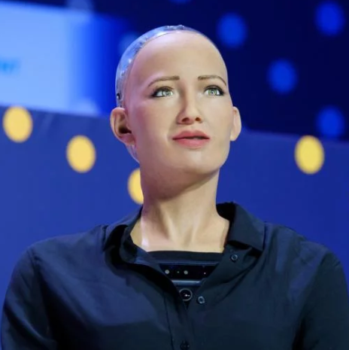
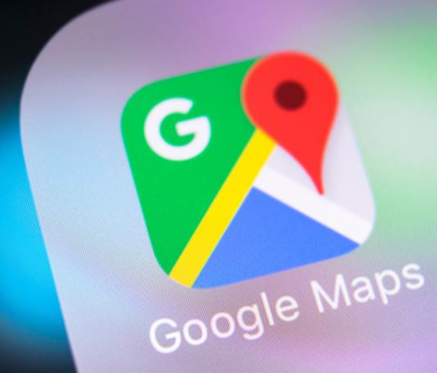

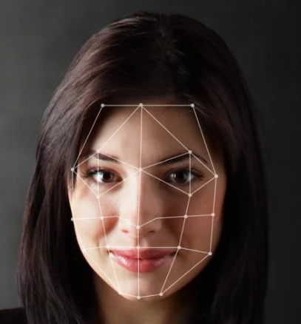

Applications of AI
Smart Navigation
ROBOTICS
Intelligent Personal Assistant
Social media
E-COMMERCE

Slide 25
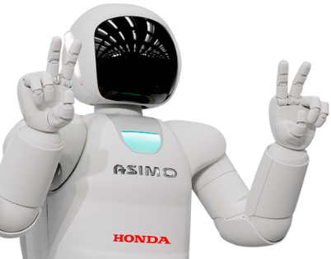
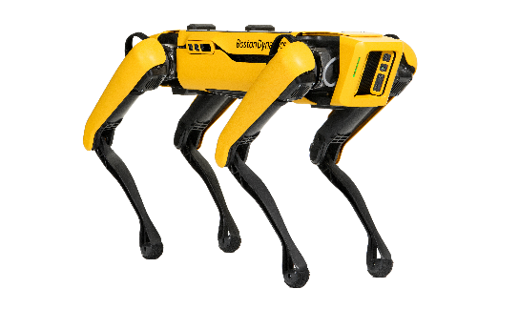
Real Life A.I. Examples
Self Driving Cars
Boston Dynamics
Navigation Systems
Humanoid robots
Virtual Personal Assistants: like Siri (Apple), Google Assistant, and Alexa (Amazon)
Email: Spam filtering
Recommendation systems: Netflix, Amazon, and Spotify
Intrusion detection
Fraud detection
personalize learning experiences

Slide 26
END

